Slide 1
Health IT Diffusion and Physician Labor Supply
Jason Huh¹ Jianjing Lin² and Lucy Xiaolu Wang^{2,3,4}
¹ Rensselaer Polytechnic Institute
² University of Massachusetts Amherst
³ Max Planck Institute for Innovation and Competition
⁴ Canadian Centre for Health Economics
Applied Economics in Digital Health Workshop, ZEW 2025.6.6

Slide 2
Rising US HIT investments enables automation
The US allocated over $30 billion to health IT adoption via HITECH Act
Health Information Technology for Economic and Clinical Health (HITECH) Act and Affordable Care Act (ACA)
Extensive research on HIT impact on quality and cost
But: limited understanding of HIT impact on physician labor supply
Focus: Computerized Provider Order Entry (CPOE), an advanced HIT and the key component of HITECH Meaningful Use (MU) criteria
E-enter treatment orders, integrate patient info and clinical guidelines, and communicate with pharmacy, laboratory, and other departments
In contrast, basic HIT systems, e.g., clinical decision systems, store patient data in digital database and provide clinical treatment support
Research question: How does advanced HIT adoption affect aggregate hospital-based (HB) physician supply at the county level?
Extensive margin: physician count per 100k population (main analysis)
Intensive margin: patient care volume (supplementary analysis)

Slide 3
Research Question:
Q: How does advanced HIT adoption affect aggregate hospital-based physician supply at the county level?
Intuitively, aggregate physician rate can go either way (empirical Qs):
More: “Time to hire more physicians to take full advantage of HIT!”
Less: “Time to automate and reduce docs (recover costs from HIT)!”
Same: “Docs come and go, on the net things may stay similar?”
Exploit the county-level sharp adoption of advanced HIT (CPOE)
Show how the plausibly exogenous HIT diffusion patterns affect county-level HB physician per 100k pop, the heterogeneity by specialties, physician career stage, physician shortage area status
Test financial mechanism and downstream impact on care utilization
Notes:
EEA = European Union member states, Iceland, Liechtenstein, and Norway.

Slide 4
Preview of Methods and Results
Methods:
Event-study approach à la East et al. (2023), leveraging the sharp increase in adoption rates to separate the sample into treatment and control groups
Here: use sharp increase in county-level advanced HIT adoption rate
Compare HB physicians per 100k in counties with rapid diffusion vs controls
Use De Chaisemartin & d’Haultfoeuille (2024) as our main DiD estimator
Main results:
10.3% increase in county-level HB physicians per 100k post HIT adoption
Effects primarily driven by medical and surgical specialties
Stronger effects among early-career docs and in areas with doc shortages
Physicians (hospitals) in treated counties received higher payments (profits)
Increased outpatient surgeries in counties w/ moderate pre-period volumes

Slide 5
Literature and Contribution
The impact of Health IT: new evidence on how HIT automation affect aggregate physician labor supply (high-skilled labor), and how the effects vary by specialty, career stage, shortage area status, and care utilization.
(Miller & Tucker, 2011; Agha, 2014; Dranove et al., 2014; McCullough et al., 2016; Freedman et al., 2018; Lu et al., 2018; Wang, 2021; Wang & Bloch, 2023; Lin & Olson, 2024; Glenn, 2024)
Physician labor supply: new technological angle that combines market-driven incentives and policy-led changes in the past decades, and study how digital technologies affect physicians, hospitals, and care provisions.
(Baker & Royalty, 2000; Garthwaite, 2012; Buchmueller et al., 2016; Falcettoni, 2018; Kulka & McWeeny, 2018; Neprash et al., 2018; Huh, 2021; Curto & Bhole, 2022; Huh & Lin 2024; Khoury et al., 2024)
Policy implications and relevant insights for managerial practices. HIT investment can improve workforce efficiency and expand access to care (reduce disparity in access) while sustaining providers’ financial health.

Slide 6
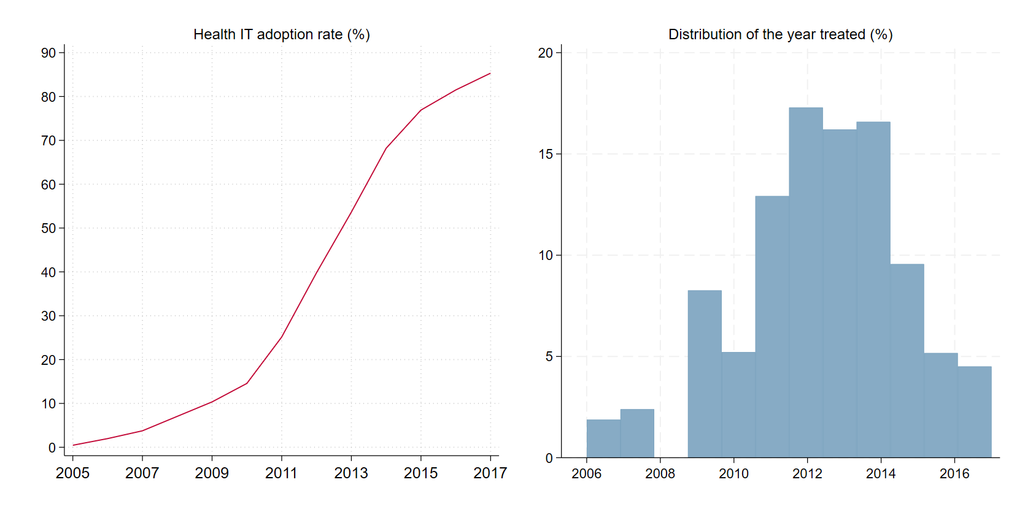
Institutional context and HIT adoption trends
Electronic health records (EHRs), the core component of HIT, were invented in 1970s but saw limited adoption until the 2000s. We focus on hospital HIT.
2010s: widespread hospital HIT adoption, driven by federal incentives
2009 HITECH Act (~ $30 billion allocation) on HIT adoption, meaningful use (MU); ACA indirect incentives (initiatives/provisions) require/facilitate HIT use.
Notes:
Mayo v. Prometheus (2012): adjust drug dosage based on metabolite levels – not patent-eligible;
Association for Molecular Pathology v. Myriad Genetics, Inc. (2013): naturally occur genes are not patent eligible.

Slide 7

HIT adoption measures: CPOE & its functionality
Computerized Provider Order Entry (CPOE): advanced HIT
Enable providers to electronically enter medication, laboratory, and radiology orders, often with built-in clinical decision support tools, core in MU criteria
Unlike other HIT component, CPOE directly structures patient data in ways that align with coding and billing requirements, esp. relevant when study health tech adoption where payment mechanisms are important
Relatively recent, CPOE is viewed as an automation health care technology
CPOE functionality: enhance efficiency and care quality in several ways
stores patient information in a centralized system to ease critical data access
provides pre-programmed, institutionally-approved templates to streamline ordering process and adherence to clinical protocols (e.g., legible, complete, …)
e-communication (previously manual) accelerates turnaround times: reduce delays between service ordering, results delivery, and payment processing
reduces clinician’s documentation burdens by min the need for data re-entry
uses clinical support systems to auto-detect drug-drug interactions in orders
An example of a CPOE interface

Slide 8
Conceptual Considerations
Physician labor supply on the extensive margin is shaped by aggregating individual location choices and broader market dynamics.
Hospitals’ perspectives:
HIT investment can affect strategic hiring of docs to fully leverage technology
Esp in geo-areas with moderate but growing demand for medical services
If increase patient throughput, boost revenue -> can hire/retain more docs
Physicians’ perspectives
Response to HIT diffusion may vary by specialty, career stage, tech-savviness
HIT can be a pull factor for early-career physicians adapted to digital tech
Patients’ perspectives
HIT can make access to services more convenient with faster scheduling
can seek elective procedures earlier and easier (limited sorting within country)

Slide 9



Data Construction
Physician supply data: Area Health Resources Files (AHRF)
Hospital-based (HB) physicians: non-federal MDs under hospital contracts providing direct patient care, measured as rate per 100k county population
Specialty categorization: medical, surgical, general practitioners, others
Health IT adoption data: Healthcare Information and Management Systems Society (HIMSS) Analytics Database
Records basic and advanced HIT adoption by hospitals, including CPOE
County-level adoption rate weighted by capacity (hospital beds)
Medicare provider and service data: CMS Medicare physician & other practitioners by provider and service dataset (available starting 2013)
Market structure and profit data: Healthcare Provider Cost Reporting Information System (HCRIS), CMS; calculate hospital HHI and profit
Sample: ~2,380 US counties during 2006-2018 outcome years matched with one-year lagged HIT adoption (excl. 2009 b/c missing AHRF data)

Slide 10
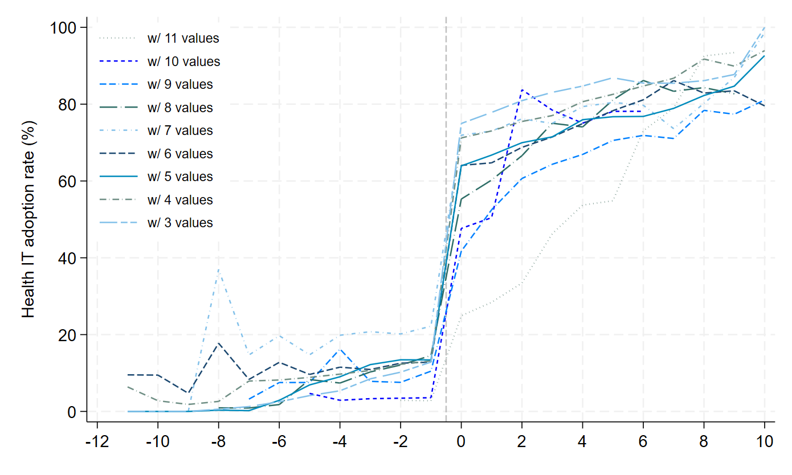
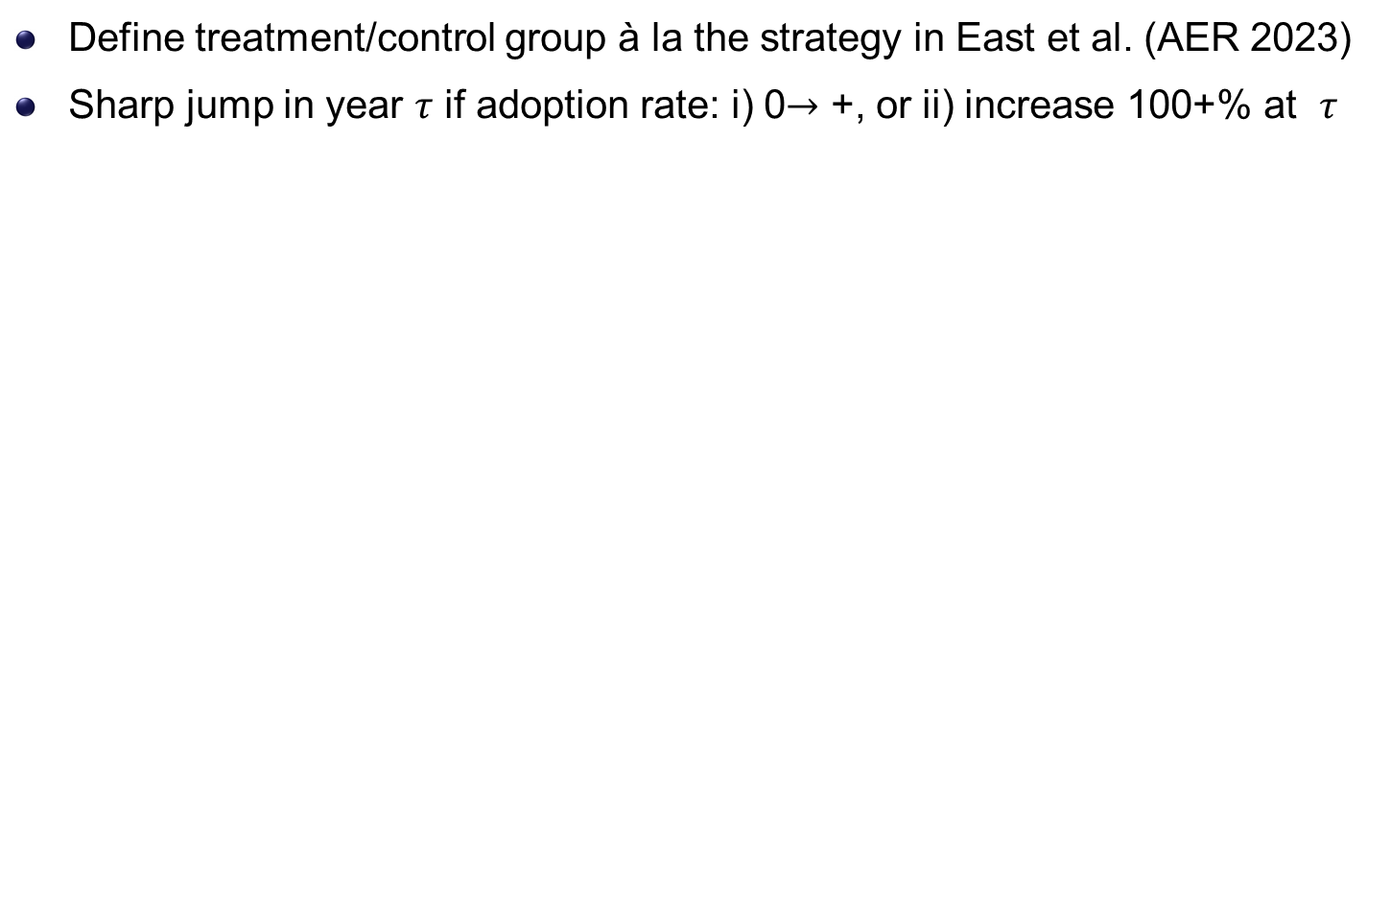
HIT treatment measure: sharp jumps in HIT rates
Define treatment/control group à la the strategy in East et al. (AER 2023)
Sharp jump in year $τ$ if adoption rate: i) 0$→$ +, or ii) increase 100+% at $τ$
Notes:
Median time-to-approval in our sample: 10 years

Slide 11
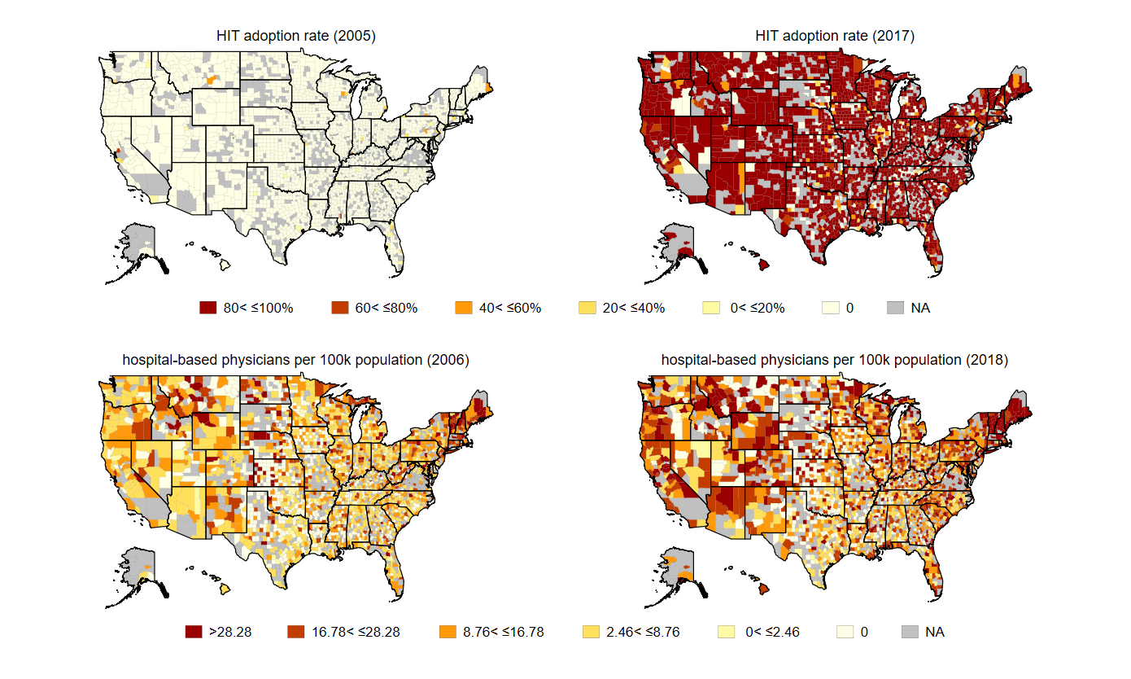
Geographic variation in HIT and physician supply
Outcome periods 2006-2018 with one-year lagged HIT 2005-2017

Slide 12
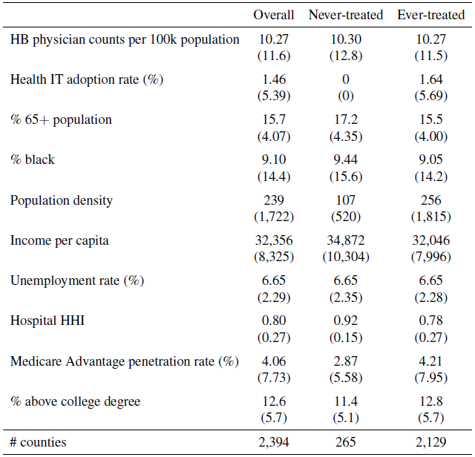
Summary statistics in pre-treatment period
Notes:
Our primary patents do not fall into one ICD-9 disease category: congenital anomalies

Slide 13
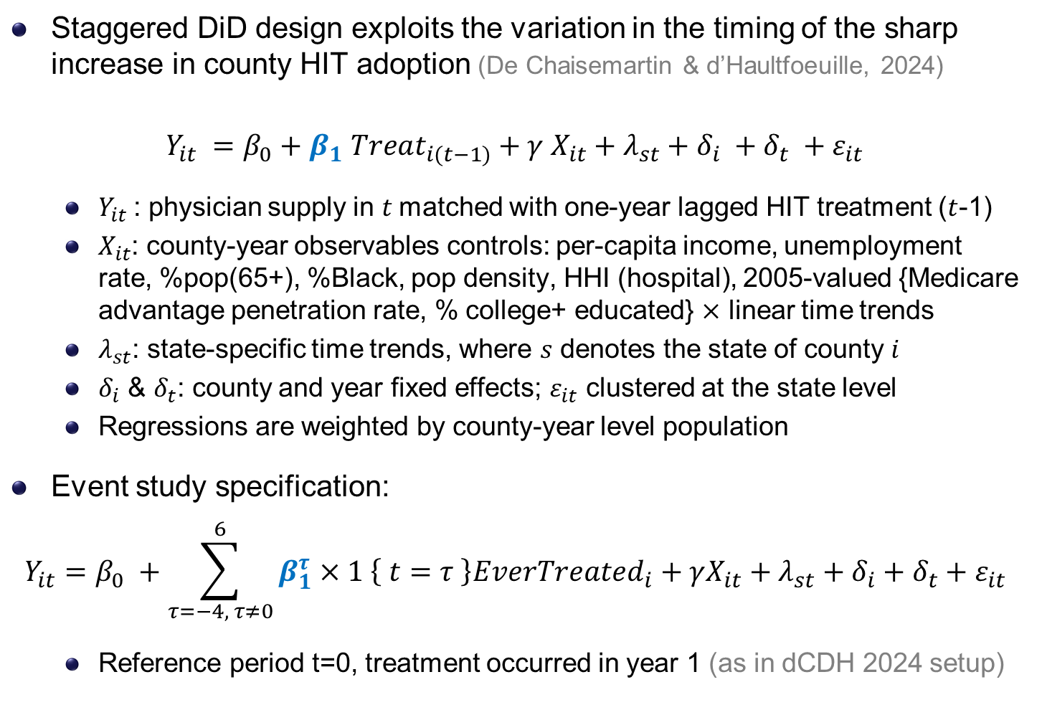
Empirical strategy: dynamic DiD & event studies
Staggered DiD design exploits the variation in the timing of the sharp increase in county HIT adoption (De Chaisemartin & d’Haultfoeuille, 2024)
$Y_{it} =β_{0}+β_{1} Treat_{i(t−1)}+γ X_{it}+λ_{st}+δ_{i} +δ_{t} +ε_{it}$
$Y_{it}$: physician supply in $t$matched with one-year lagged HIT treatment ($t$-1)
$X_{it}$: county-year observables controls: per-capita income, unemployment rate, %pop(65+), %Black, pop density, HHI (hospital), 2005-valued {Medicare advantage penetration rate, % college+ educated} $×$ linear time trends
$λ_{st}$: state-specific time trends, where $s$ denotes the state of county $i$
$δ_{i}$ & $δ_{t}$: county and year fixed effects; $ε_{it}$ clustered at the state level
Regressions are weighted by county-year level population
Event study specification:
$$Y_{it}=β_{0} +\sum_{τ=−4, τ≠0}^{6}{β_{1}^{τ}×1 \left\{ t=τ \right\}EverTreated_{i}}+γX_{it}+λ_{st}+δ_{i}+δ_{t}+ε_{it}$$
Reference period t=0, treatment occurred in year 1 (as in dCDH 2024 setup)

Slide 14
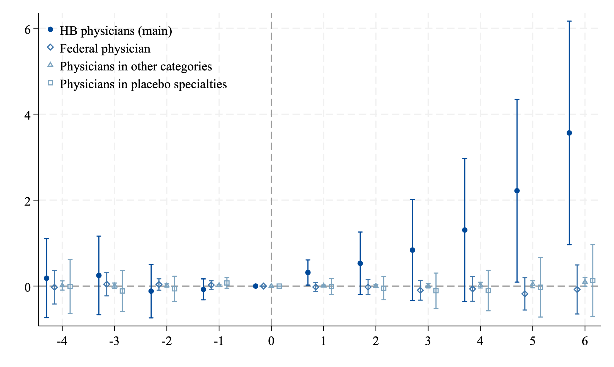
HIT diffusion & HB physician: main results
Main outcome: HB physicians per 100k pop. vs. three falsification groups
employed by the federal gov (e.g., Army, Navy, Air Force, VA, PH)
those not provide patient care but work in research/teaching/admin.
dermatology, aerospace med., forensic pathology, med genetics, occupational meds, nuclear meds, PH & general preventive med.

Slide 15
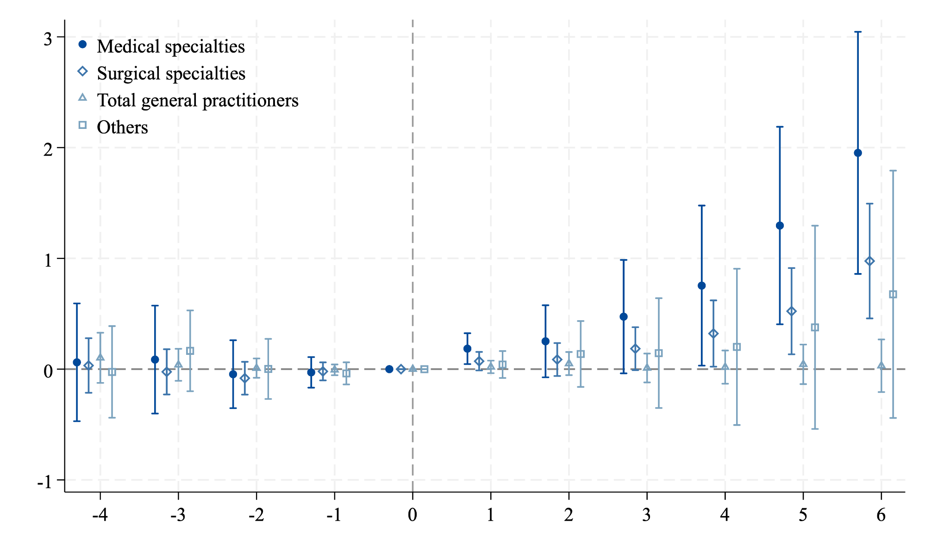
Heterogeneity cross-specialty within HB physicians
Medical: allergy and immunology, cardiovascular disease, gastroenterology, internal medicine (general, subspecialties), pediatrics (general, subspecialties, cardiology), pulmonary disease.
Surgical: colon/rectal surgery, general surgery, neurological surgery, obstetrics-gynecology (general, subsp.), ophthalmology, orthopedic surgery, otolaryngology, plastic surgery, thoracic surgery, urology
Total GP: general practice, family medicine (general subspecialties)
Others: anesthesiology, radiology, diagnostic radiology, emergency med., general preventive med., neurology, pathology (anatomic/clinical), physical medicine/rehabilitation, radiation oncology, transplant surgery, vascular med., other specialties, unspecified.

Slide 16
HIT Diffusion or Physician Practice Consolidation?
Consolidations (vertical/horizontal) may expand physician networks and accelerate HIT adoption within health systems simultaneously…
A system is defined as either an independent hospital or an integrated health care delivery network w multiple hospitals and affiliated non-hospital facilities
Health systems acquire physician practices to get more patients (Baker et al., 2016)
Systems, w greater financial & tech capacities, often adopt HIT early (Agha 2014)
We identify health system that experienced …
a merger & acquisition (M&A), if the # hospitals within the system increased in a given year compared to the previous year.
a vertical integration (VI), if the # ambulatory care units within the system increased in a given year compared to the previous year.
Aggregate: county-level, substantial M&A/VIs if > median (over sample)
0.167 for M&As and 0.25 for VIs (VIs are more common than M&As here)

Slide 17
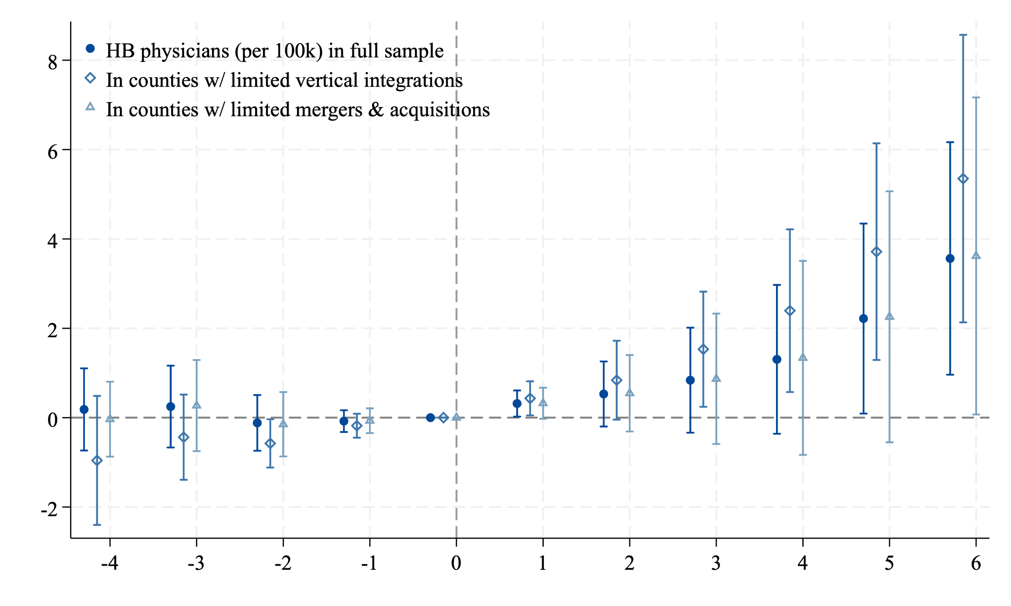
Robust results in counties with limited consolidation

Slide 18
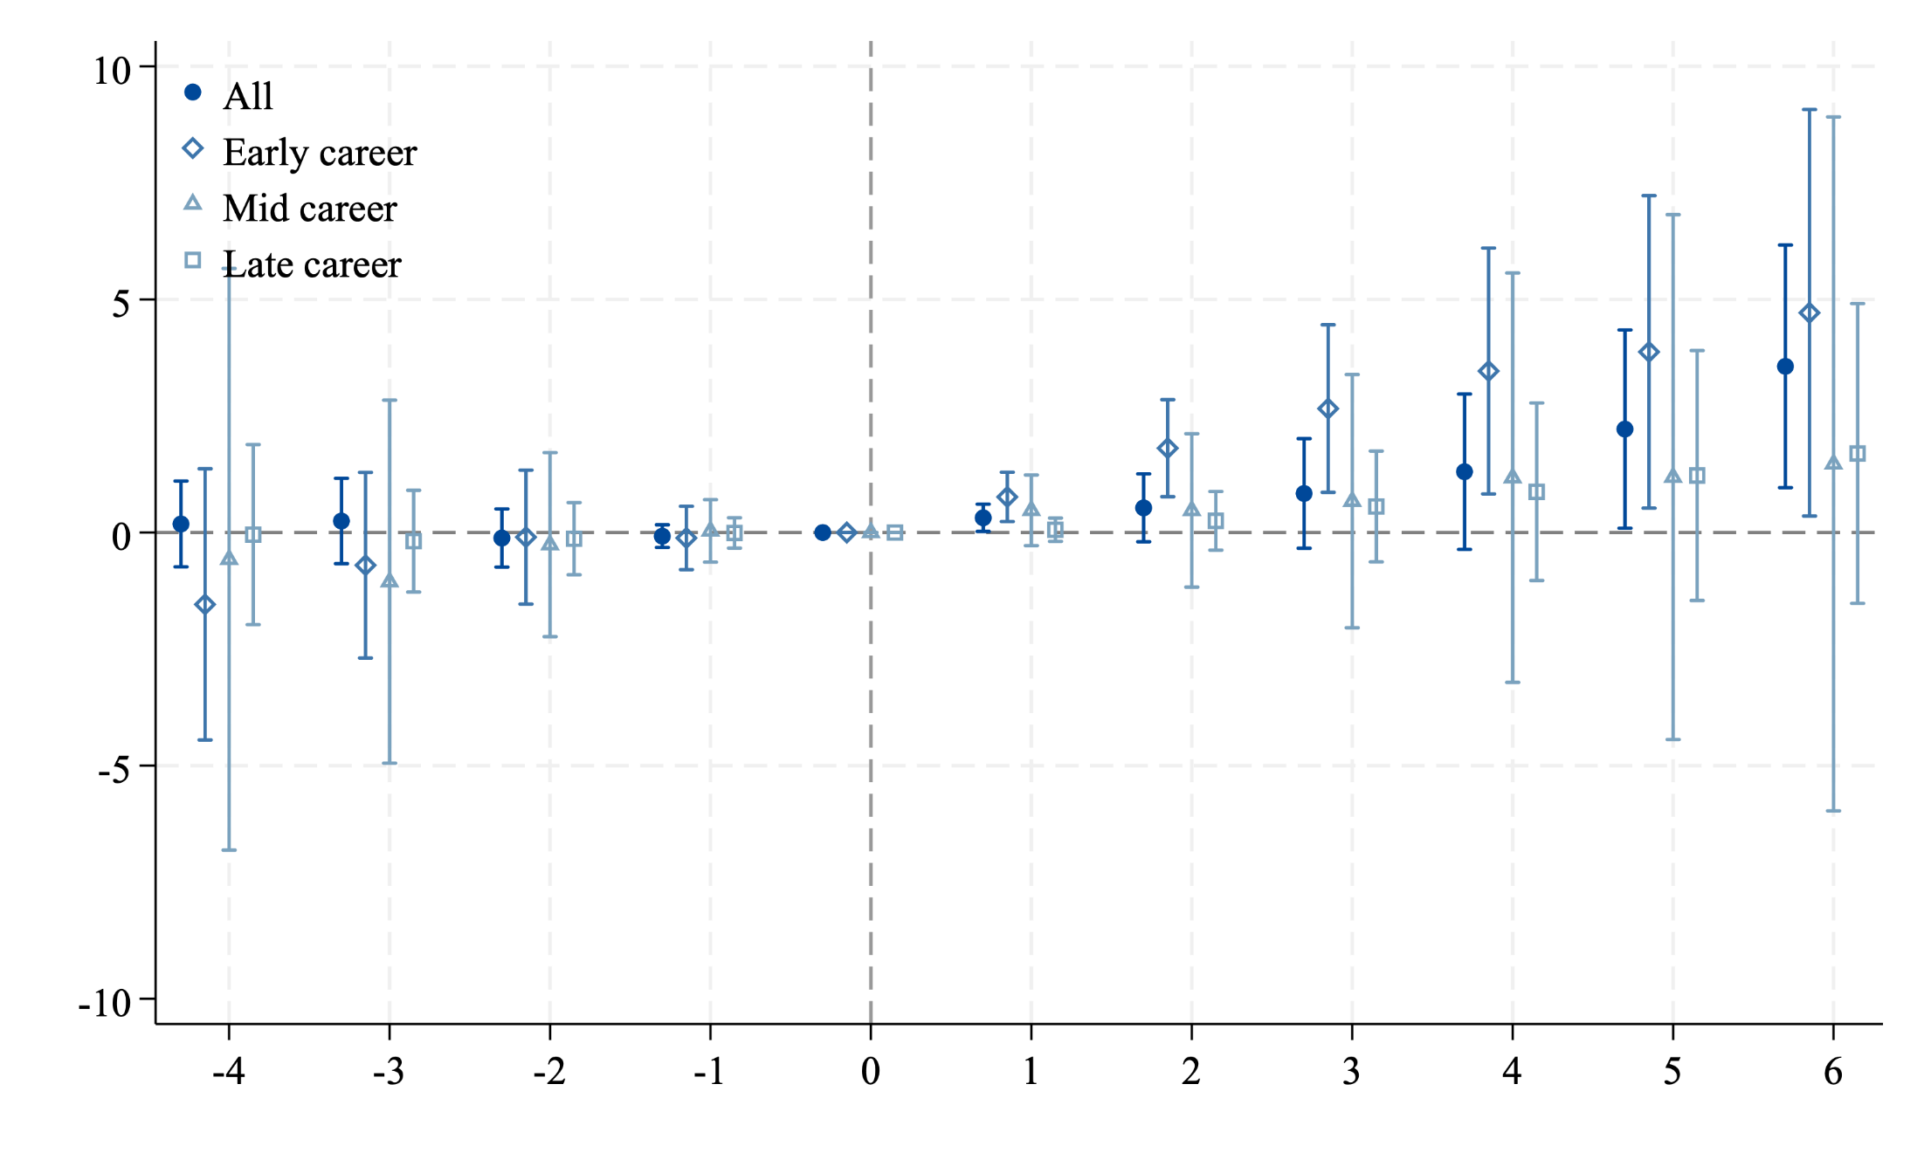
Heterogeneity by physician career stage (age group)
Early-career (under 45), mid-career (45-64), late-career (65+)
Note: AHRF does not distinguish HB vs office-based physician by age groups

Slide 19
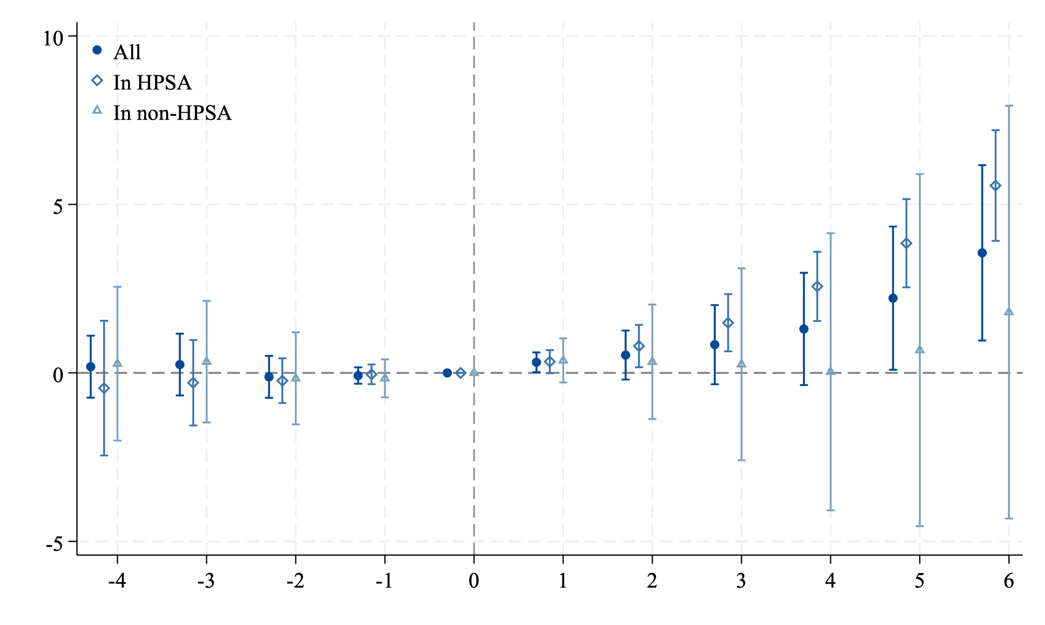
Heterogeneity by Physician Shortage Area Status
by Health Professional Shortage Area (HPSA) designation status
A county is ever-HPSA if at least part of the county was ever designated as having a shortage of primary care practitioners.
age x HPSA interaction

Slide 20
Potential Mechanism: the Financial Impact of HIT
HIT investment costs $$$ and time… Is it worthwhile?
Do HB physicians benefit financially from practicing in areas with HIT?
Do hospital benefit financially from HIT and the comp. human capital?
Ideally, we want detailed data on physician payments across payers
In practice, we use three proxies for physician/hospital’s performance:
[physician] 1) avg Medicare-allowed amounts per HB physician (incl. Medicare payments, patient deductibles and coinsurance, and any third-party contributions), 2) avg # of distinct Medicare beneficiaries per HB physicians
id. HB docs as these w 90+% services in hosp. inpatient/ER (CMS defn.), then compute county-level avg measures over all HB docs by county
[hospital] 3) average hospital profit across hospitals within each county
Test a financial mechanism through which HIT affects/retains HB docs

Slide 21
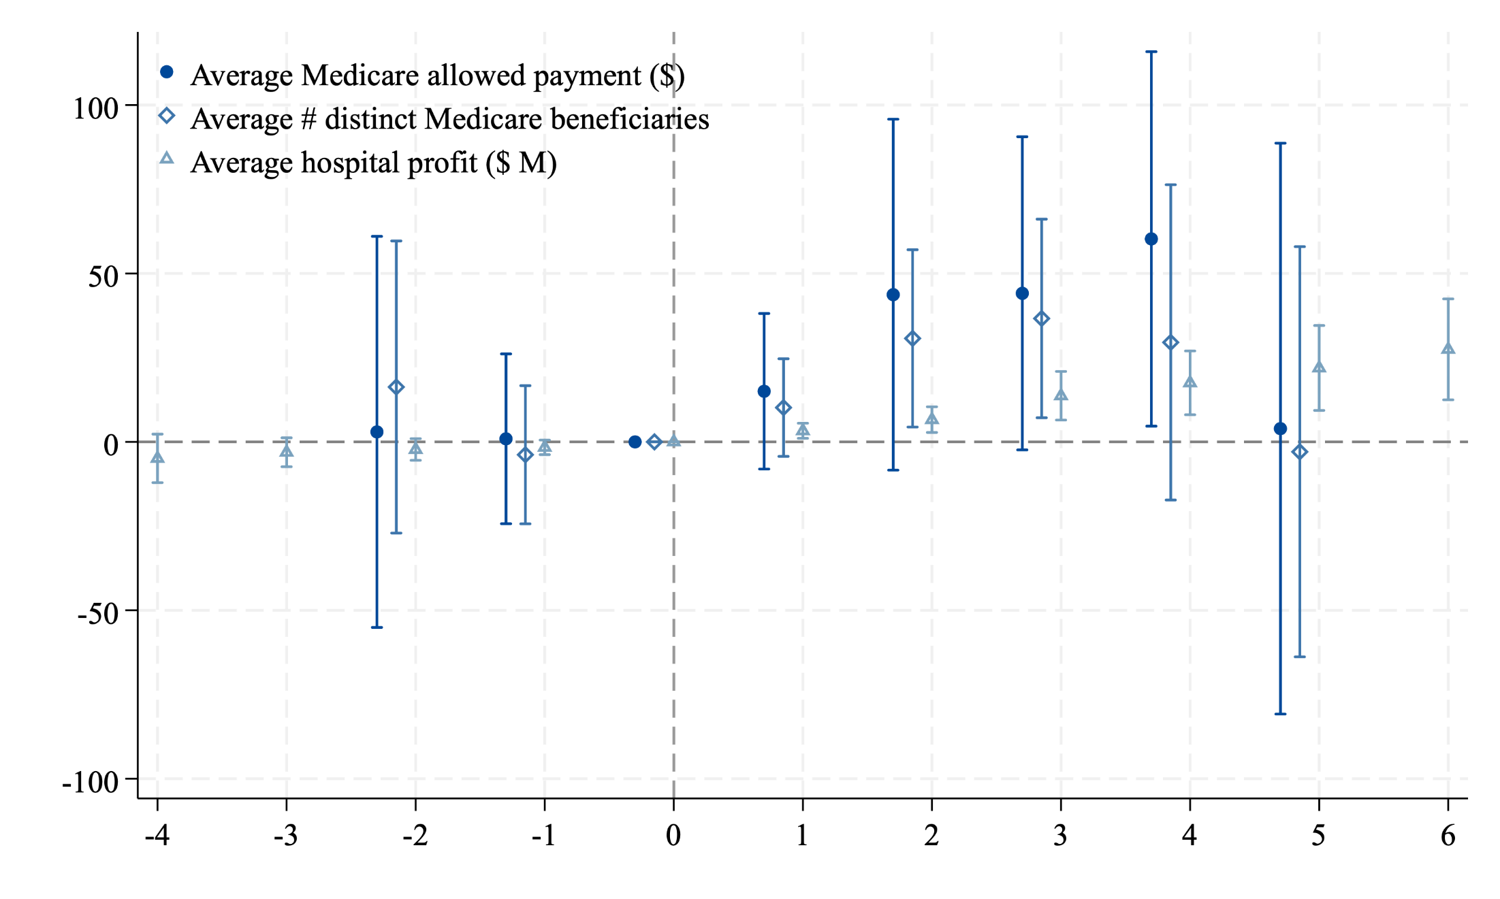
Increased financial metrics for physicians & hospitals

Slide 22
Heterogeneity by utilization: doc supply & care vol.
Knowing that $ goes up. Given the interplay between provider capacity and service demand, how about patient care utilization post treatment?
Specifically, whether physician supply responses to HIT diffusion vary by pre-period local health care utilization levels? And how this, in turn, influences subsequent service use? (demand-supply dynamics)
Two main utilization measures: outpatient and inpatient surgical operations at short-term general hospitals, per 100k pop (county level)
Other measures: outpatient visits and Medicare inpatient discharges
Outpatient elective surgeries has the highest profit margins, thus are where we expect highest increases in docs/vols (extensive, intensive margin)
Inpatient surgery volume may not respond, but more HB docs are still good
Esp. where the pre-period demand are moderate (geo w growth potentials)

Slide 23
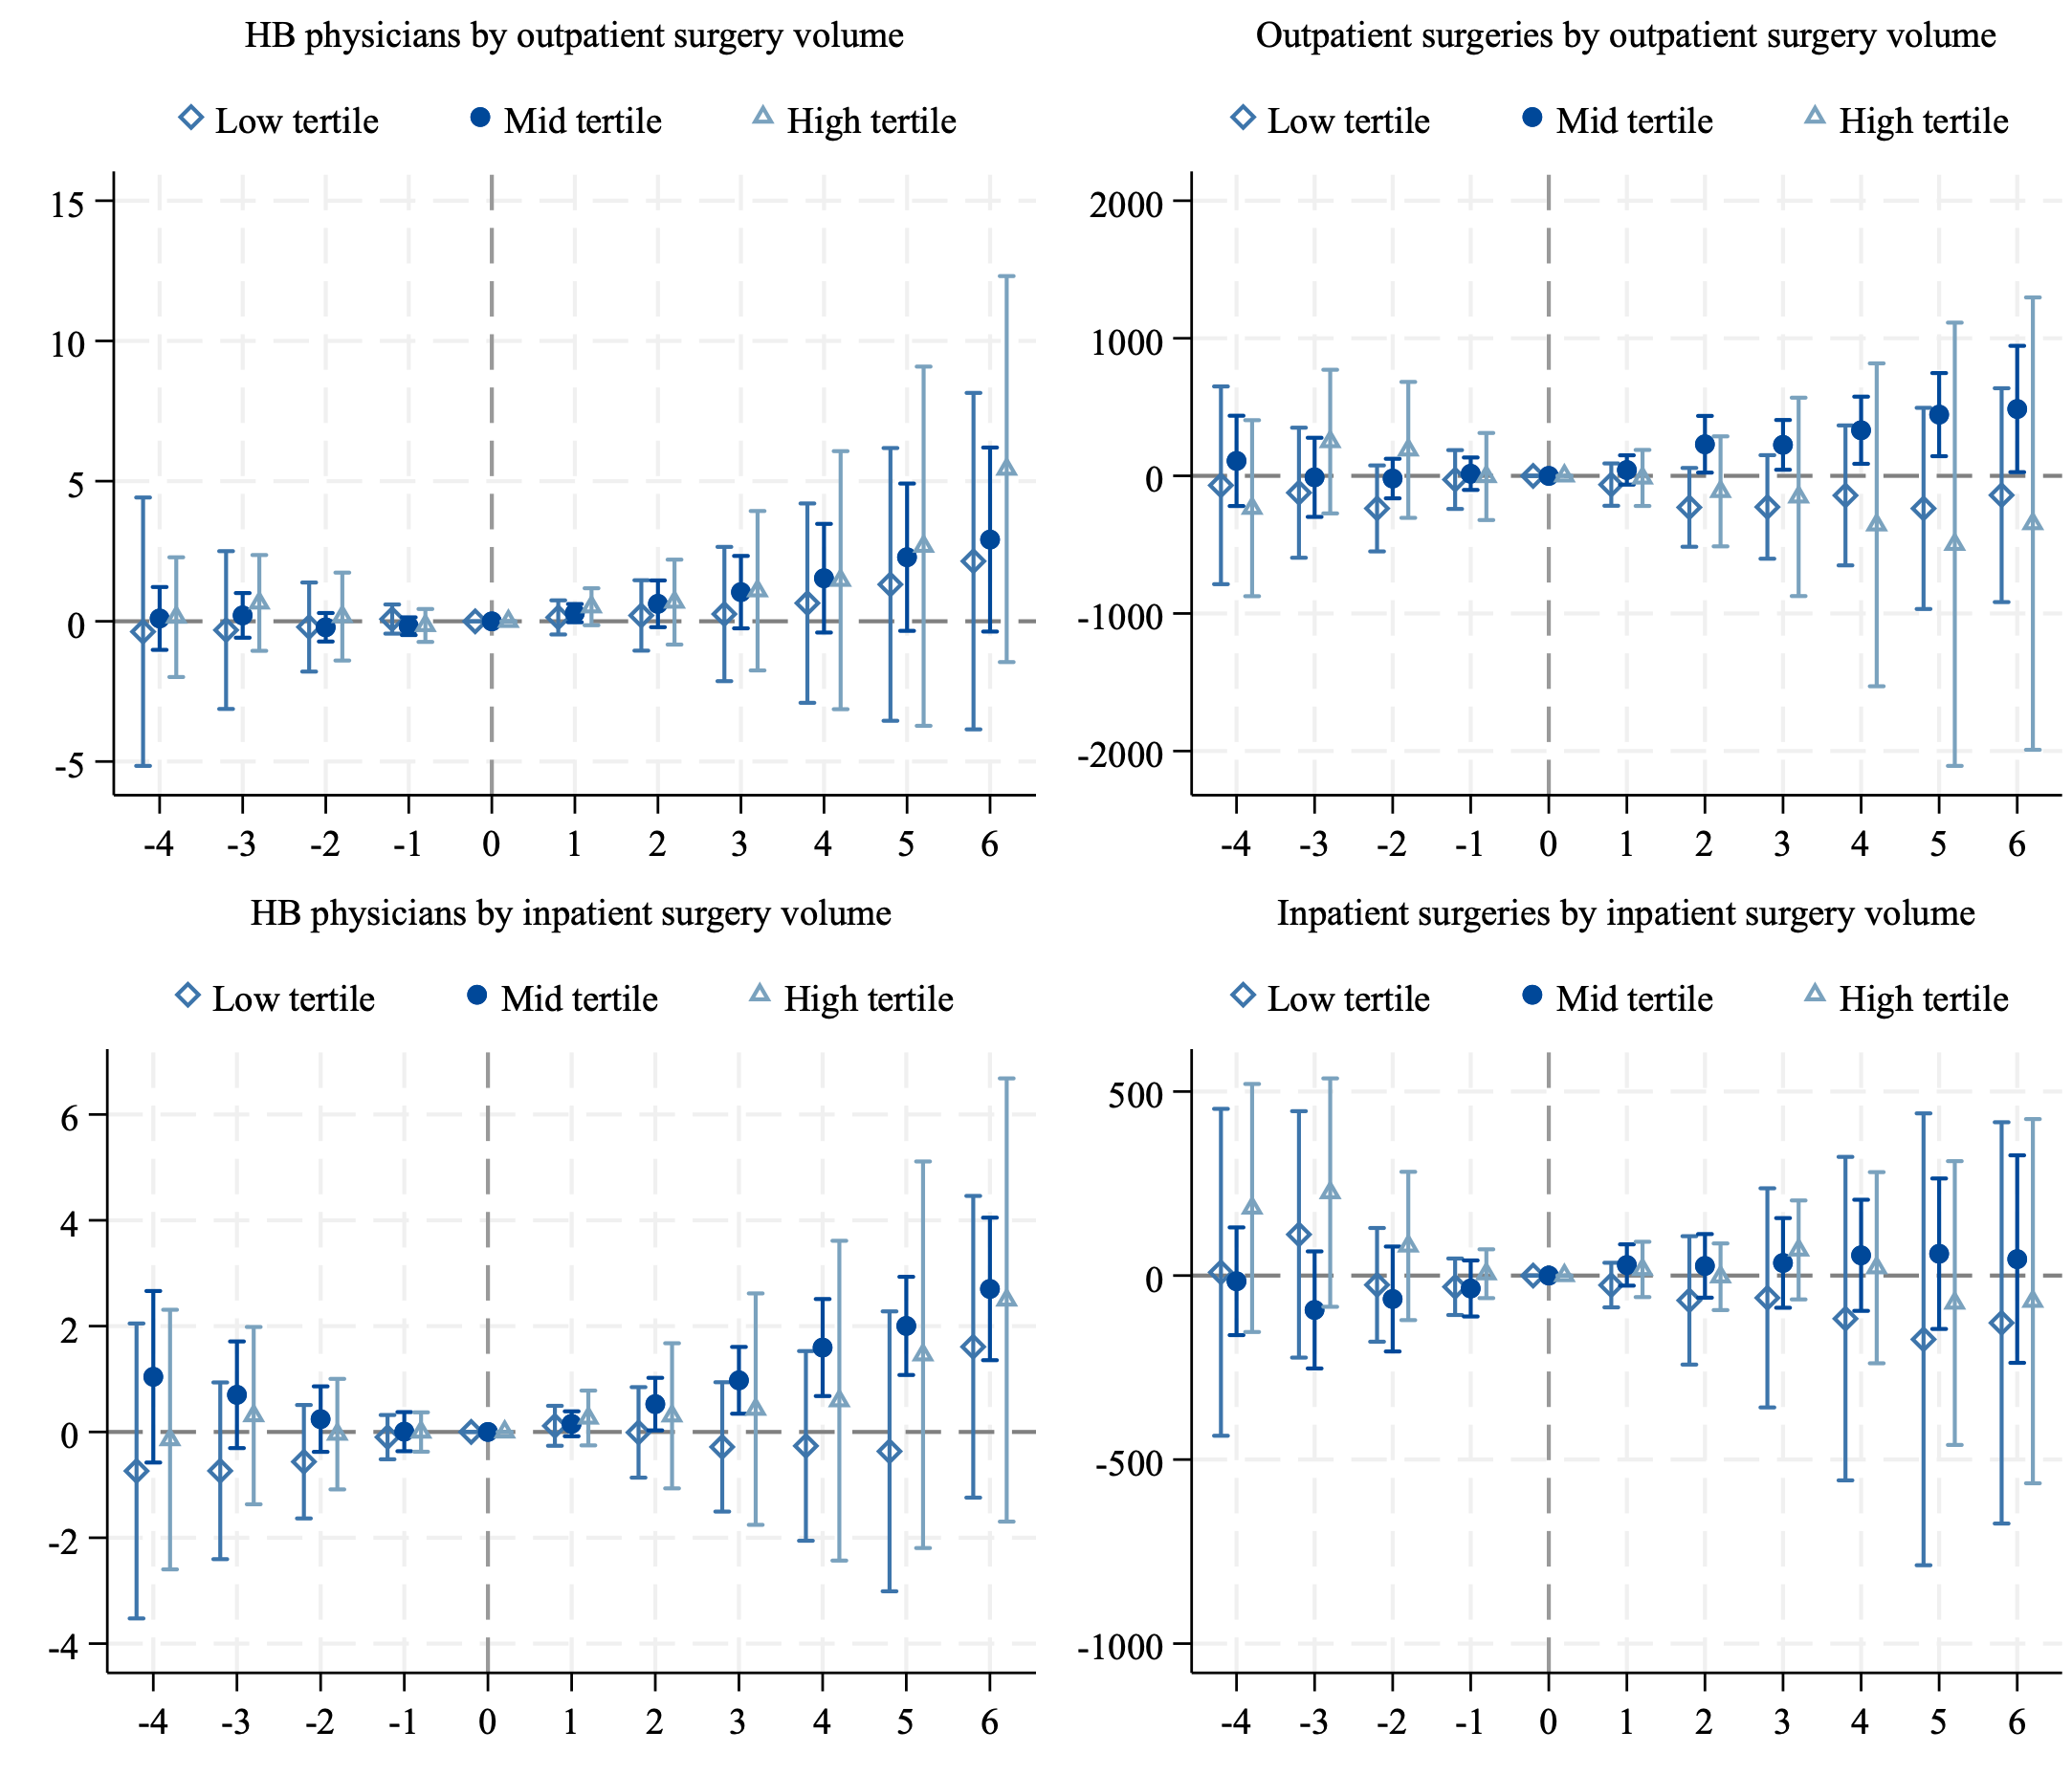
Heterogeneity by utilization, by surgery tertiles
other yvars

Slide 24
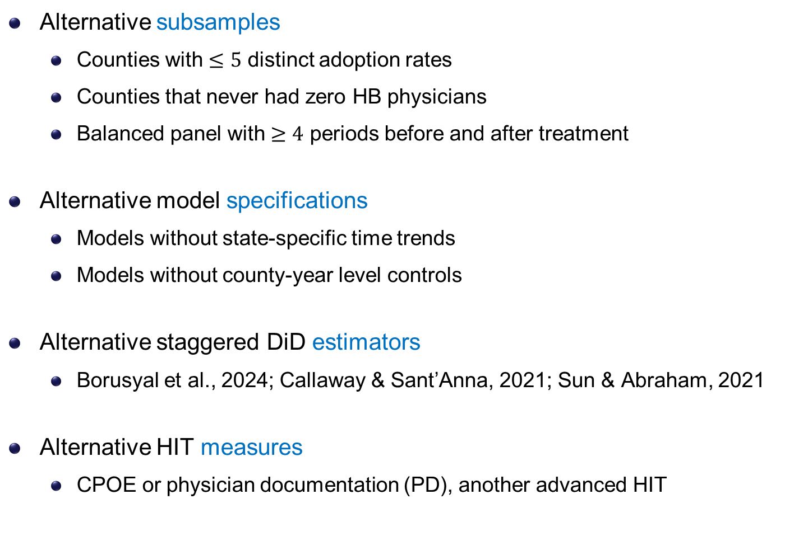
Robustness checks
Alternative subsamples
Counties with $≤5$ distinct adoption rates
Counties that never had zero HB physicians
Balanced panel with $≥4$ periods before and after treatment
Alternative model specifications
Models without state-specific time trends
Models without county-year level controls
Alternative staggered DiD estimators
Borusyal et al., 2024; Callaway & Sant’Anna, 2021; Sun & Abraham, 2021
Alternative HIT measures
CPOE or physician documentation (PD), another advanced HIT
subsample
specifications
estimators
measures

Slide 25
Limitations and Future Work
Analyses based on aggregate data
☺ mitigate concerns about patient sorting (limited sorting at county level)
☹ limit our ability to disentangle changes at the physician level (e.g., replacing retiring physicians w junior docs, PCP vs specialists, roles…)
Focus on digital tech but not fully capture physical med tech (data limit)
comprehensive controls mitigate concerns that other tech drive the results
Cannot distinguish more nuanced source of responses
domestic vs international physicians, initial vs lateral practice location choices
Not directly link with downstream health outcomes: HIT or docs?
HIT is one element within broader, team-based care delivery process
We demonstrate there can be direct and indirect effects via physician supply

Slide 26
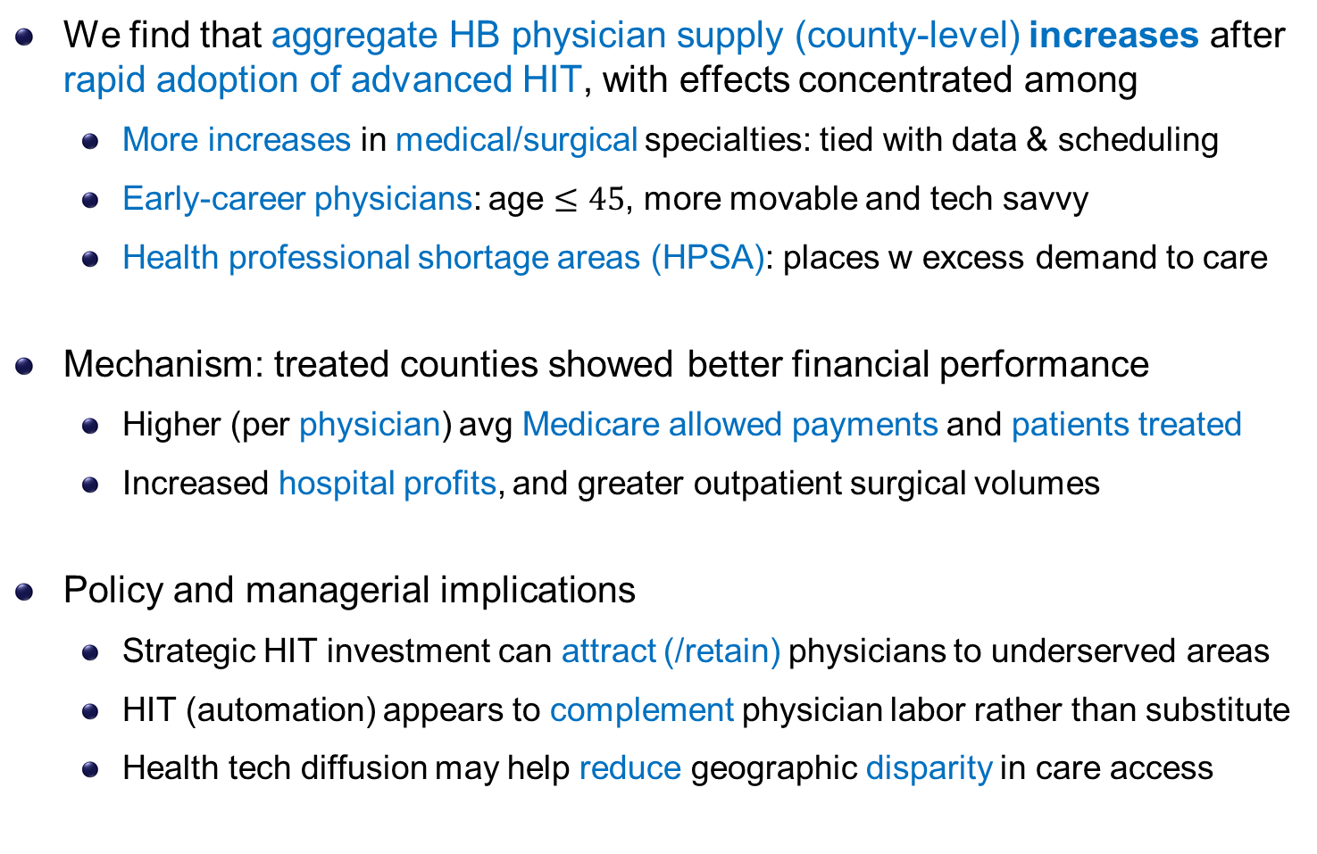
Conclusion & Discussion
We find that aggregate HB physician supply (county-level) increases after rapid adoption of advanced HIT, with effects concentrated among
More increases in medical/surgical specialties: tied with data & scheduling
Early-career physicians: age $≤45$, more movable and tech savvy
Health professional shortage areas (HPSA): places w excess demand to care
Mechanism: treated counties showed better financial performance
Higher (per physician) avg Medicare allowed payments and patients treated
Increased hospital profits, and greater outpatient surgical volumes
Policy and managerial implications
Strategic HIT investment can attract (/retain) physicians to underserved areas
HIT (automation) appears to complement physician labor rather than substitute
Health tech diffusion may help reduce geographic disparity in care access

Slide 27

Health IT Diffusion and Physician Labor Supply
Jason Huh (RPI), Jianjing Lin (UMass Amherst), Lucy X Wang (UMass Amherst; MPI; CCHE)
Emails: huhj2@rpi.edu, jianjinglin@umass.edu, xiaoluwang@umass.edu

Slide 28
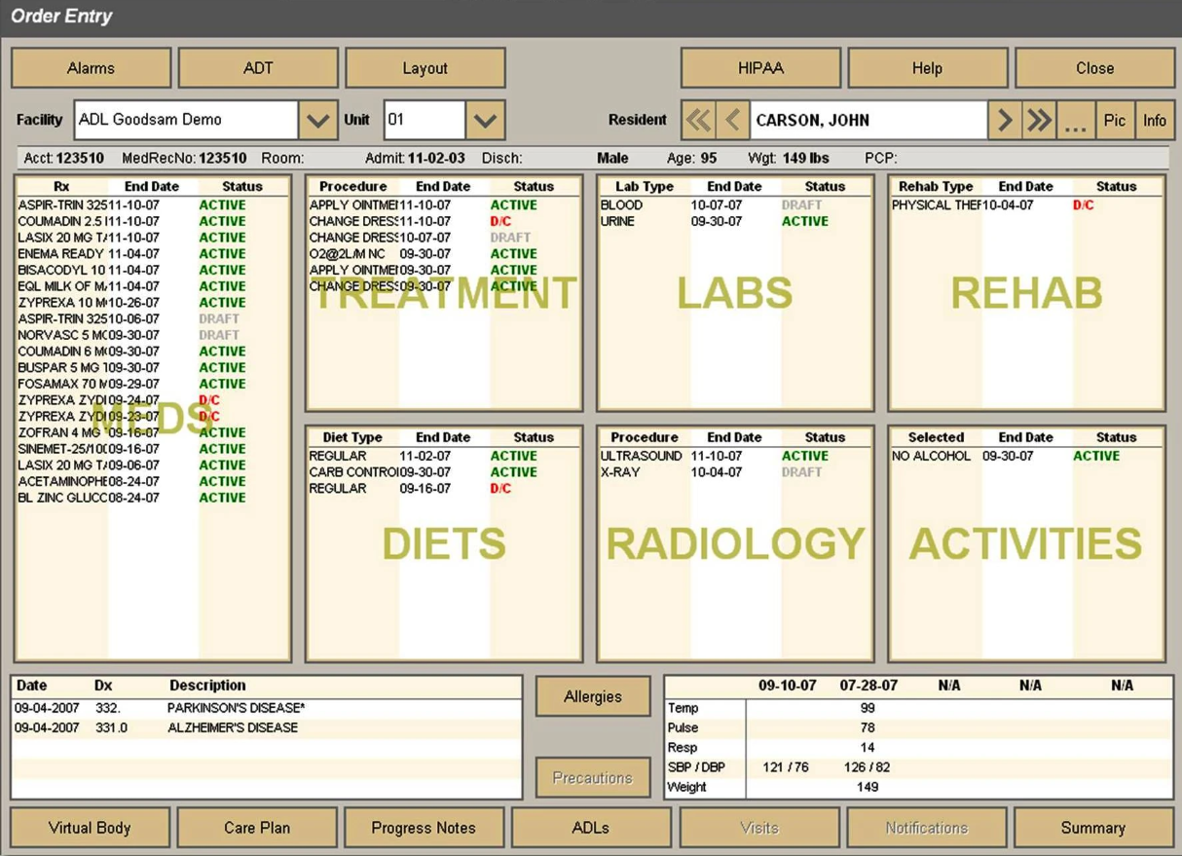
An Example of a CPOE Interface
back

Slide 29
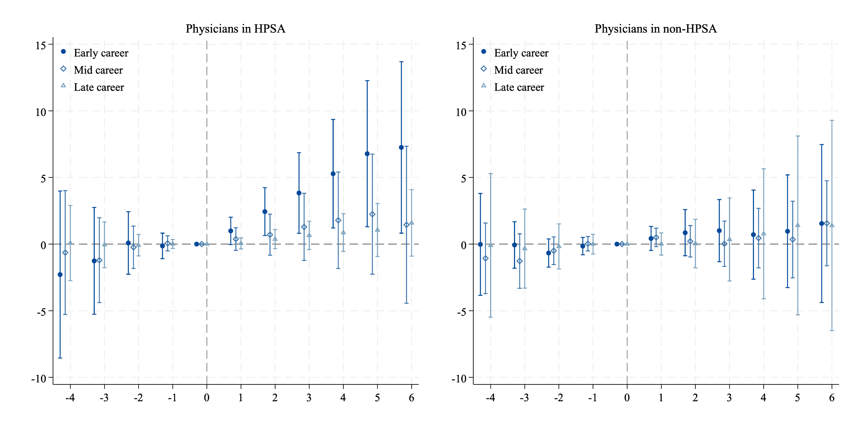
Heterogeneity by career stage and HPSA status
back

Slide 30
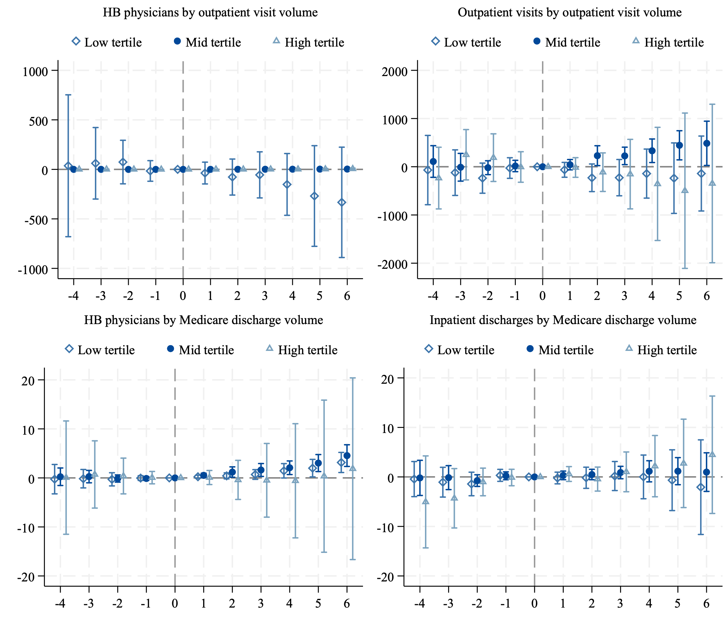
Heterogeneity by other utilization measures
back

Slide 31
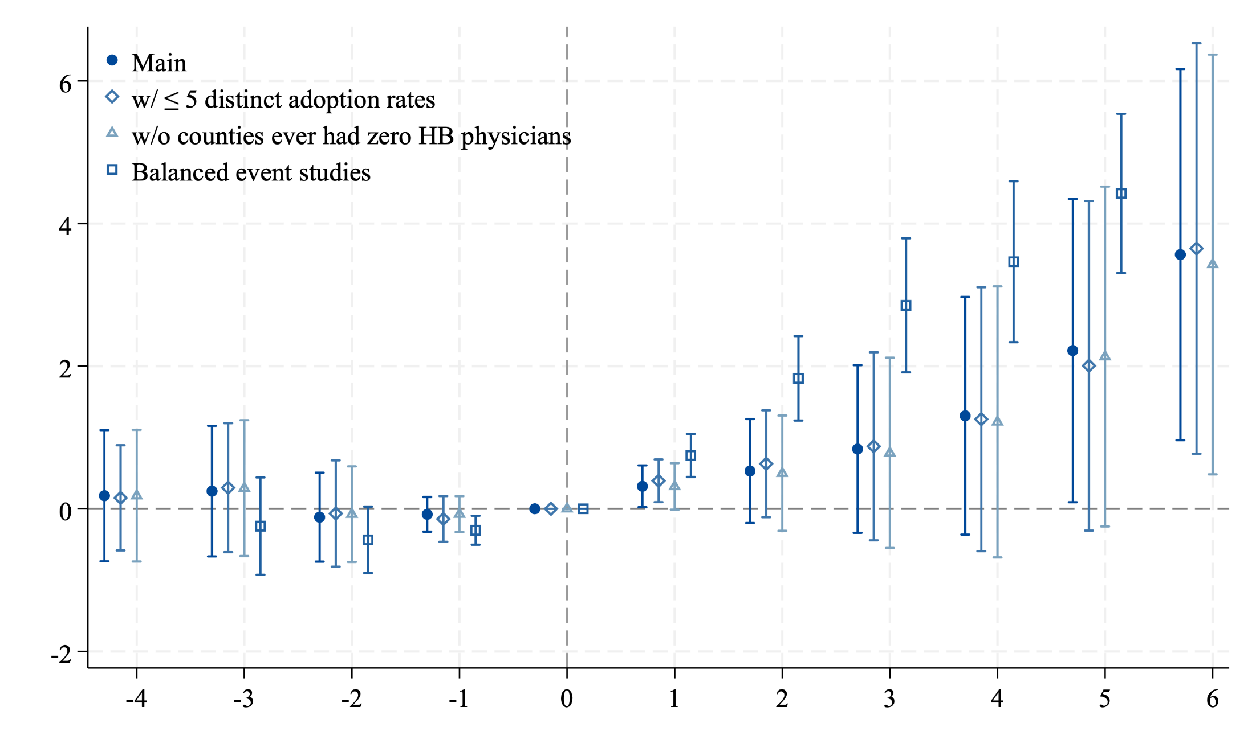
Robustness check: subsample sensitivity checks
back

Slide 32
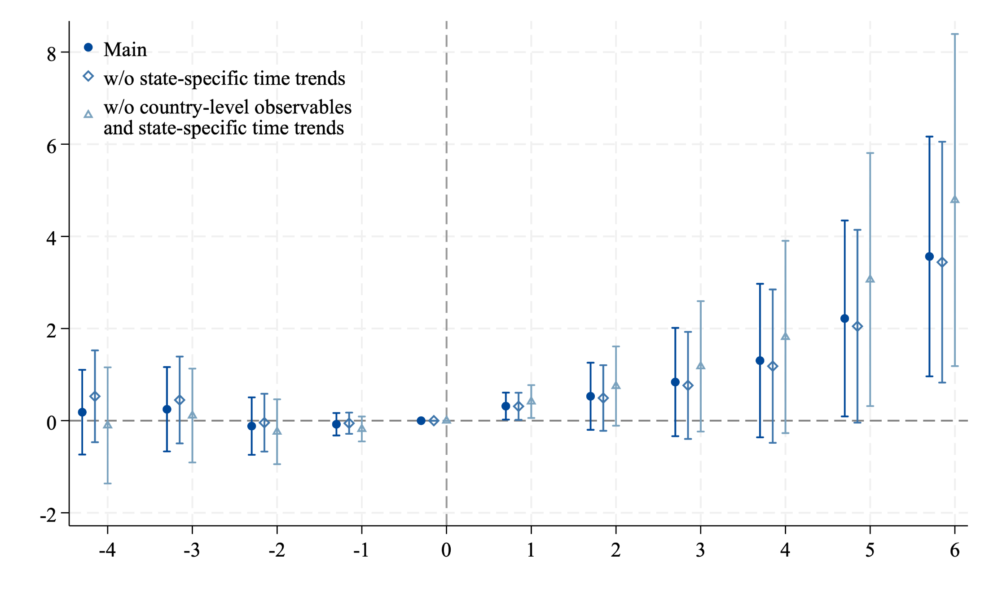
Robustness check: specification checks
Note the main specification always include state-specific time trends and county-level (including county-year level) observables.
back

Slide 33
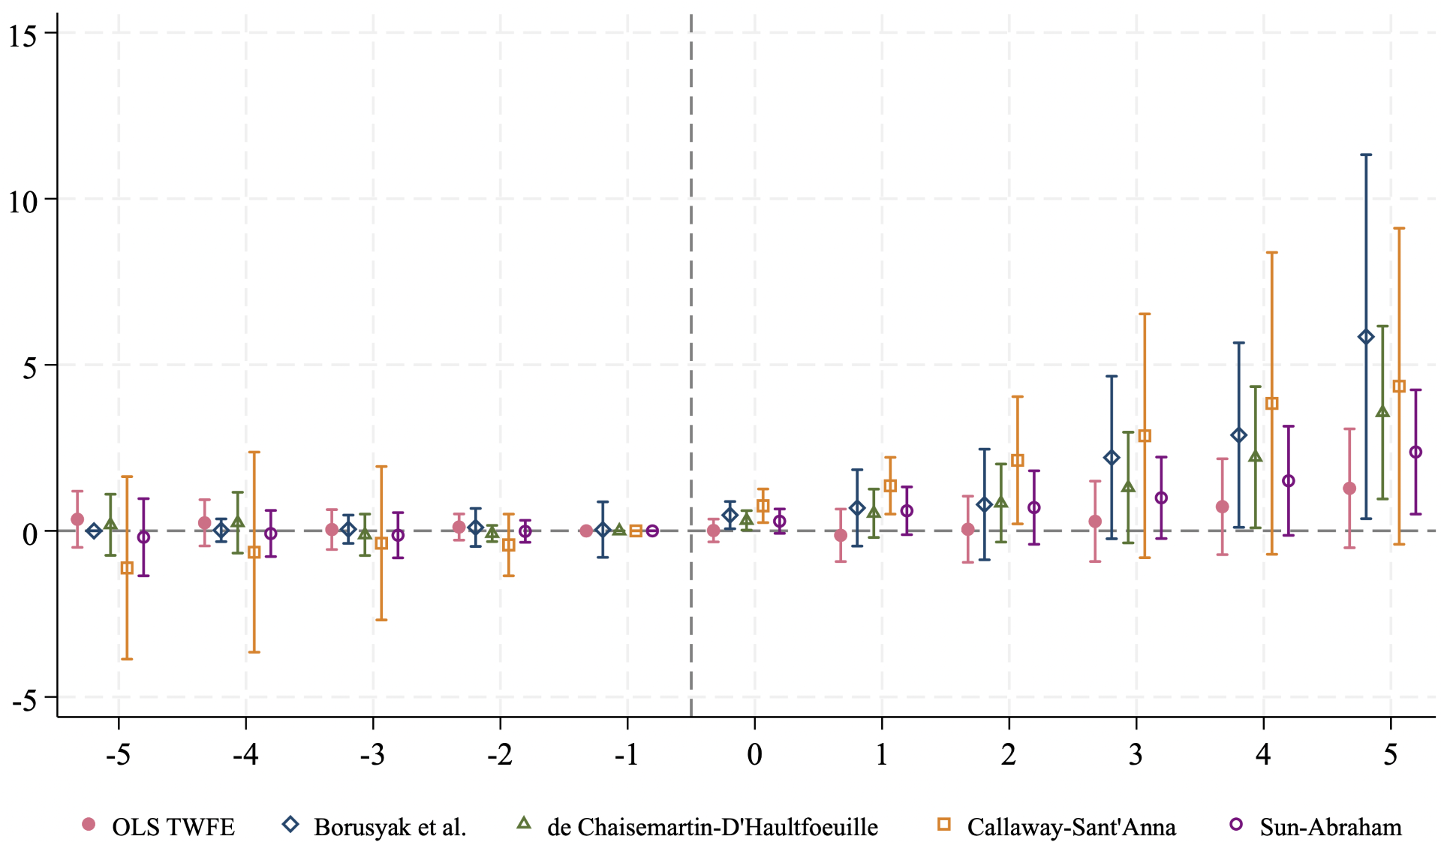
Alternative DiD estimators for the main outcome
All estimators use t=-1 as the reference except Borusyak et al., which uses the earliest period as the baseline period.
back

Slide 34
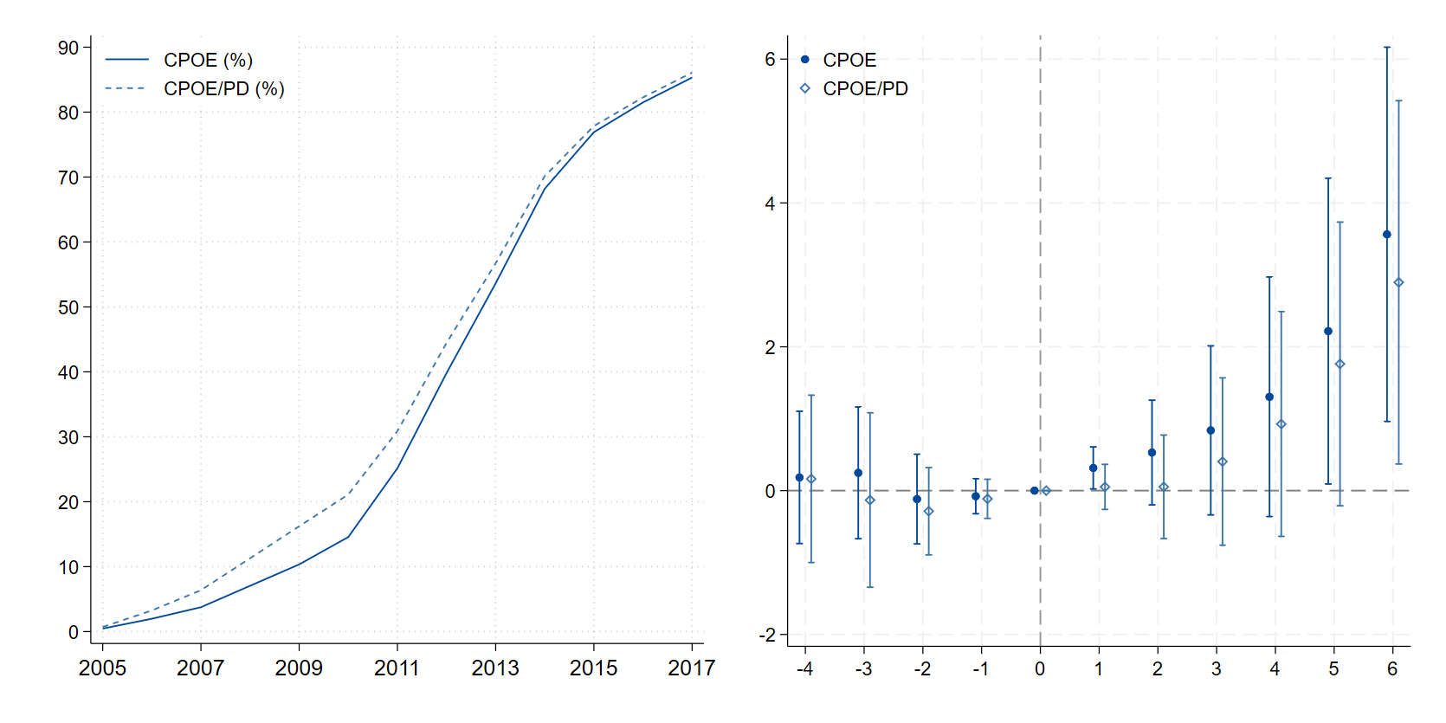
Alternative HIT measures: CPOE/PD adoption
Alt. HIT adoption measures: county-level sharp adoption of either CPOE or physician documentation (PD) – another advanced HIT component (noted in Dranove et al., 2014) but not core for HITECH act MU criteria.
back

